Slide 1
Simple Accounting System
OOP Fighters:
Hazel-Ivy M. Acebuche
Jonar Bertulfo
Mary Grace
Cheenee C. Bico
BSIT 2-2
Subject: Object Oriented Programming II
Jenny May Cinco MSIT

Slide 2
I. Objectives:
Present the problem
Show MS Word of Ma’am Cinco

Slide 3
II. Advantages
Automated (computing of tax due is easier compared to manually computing data)
Accuracy of data
Clean and user friendly interface
Informative (when hovering or clicking labels, information will appear)

Slide 4
Limitations:
Not all taxes are covered
No database for saving, updating, or retrieving of data
Purely calculation, no balance sheet, income statement, etc

Slide 5
III. Information Gathering
Consultation (questions asked)
Notes
BIR Form
Websites used

Slide 6
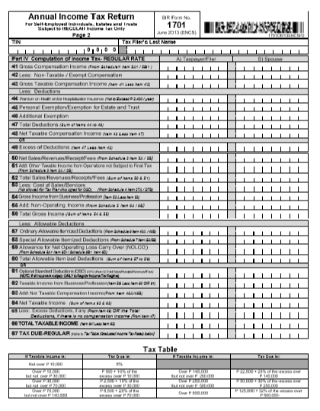
BIR Form

Slide 7
IV. User-Interface
Present design and explain
Present UI
Present code

Slide 8
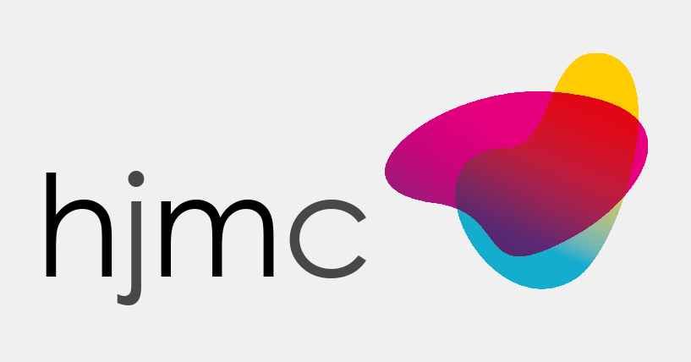
Design (Logo)

Slide 9
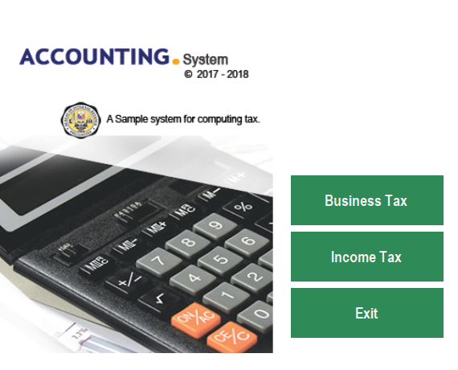

Slide 10
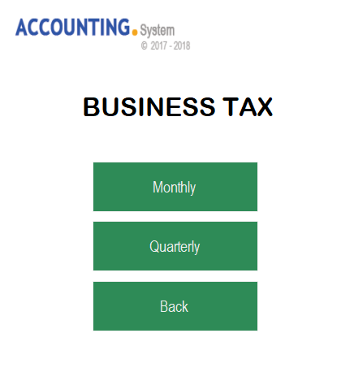

Slide 11
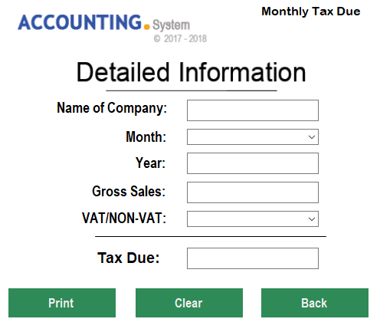

Slide 12
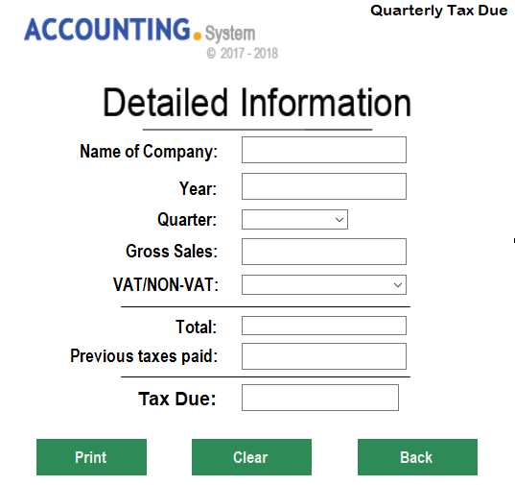

Slide 13
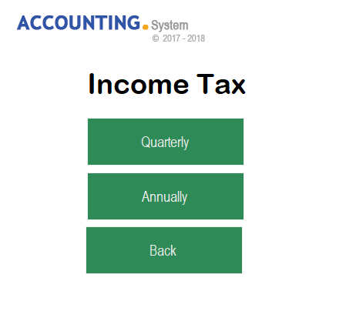

Slide 14
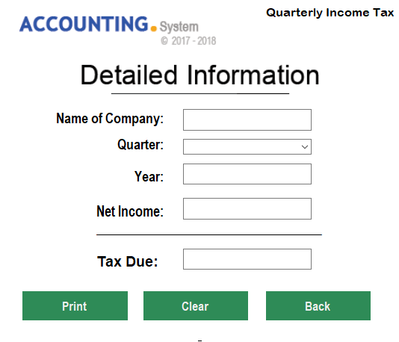

Slide 16
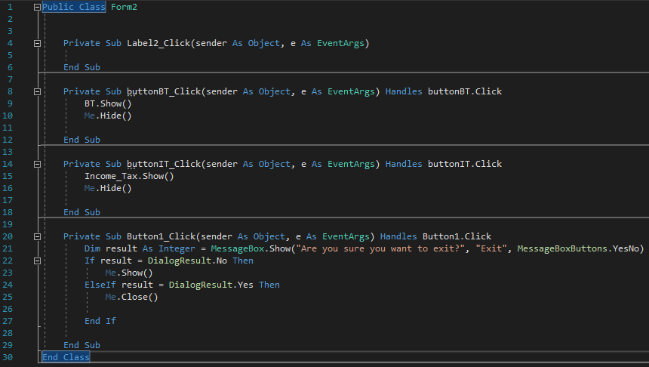
Code (Main Menu)

Slide 17
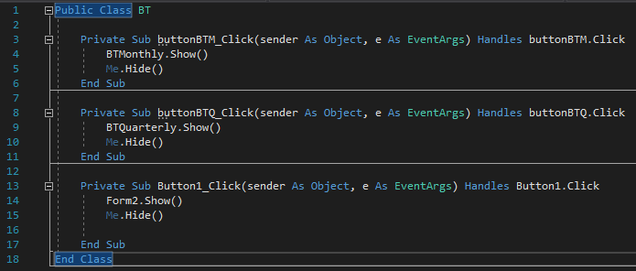
Code (Business Tax-Menu Form)

Slide 18
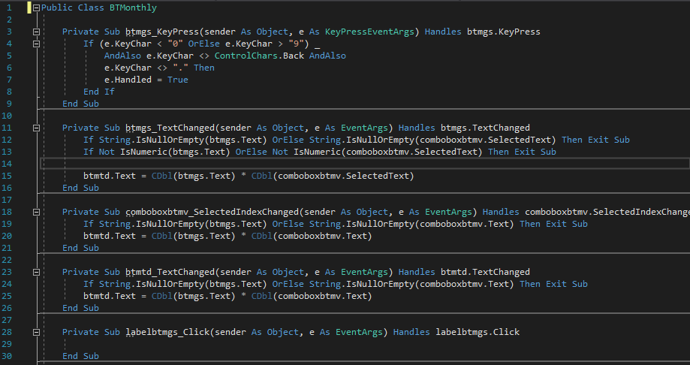
Code (Business Tax-Monthly)

Slide 19
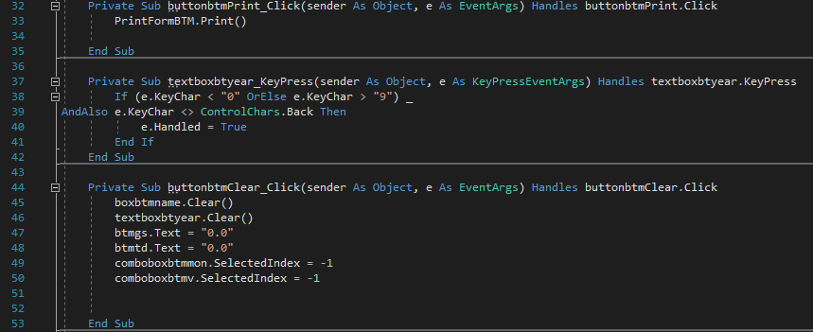

Slide 20
